Slide 1
Enhancing First-Year Economics Students’ Engagement with Mathematics Through Student-Produced Videos
Ida Landgärds-Tarvoll, ida.landgards@uia.no Anders Skarpeteig Fidje, anders.s.fidje@uia.no

Slide 2
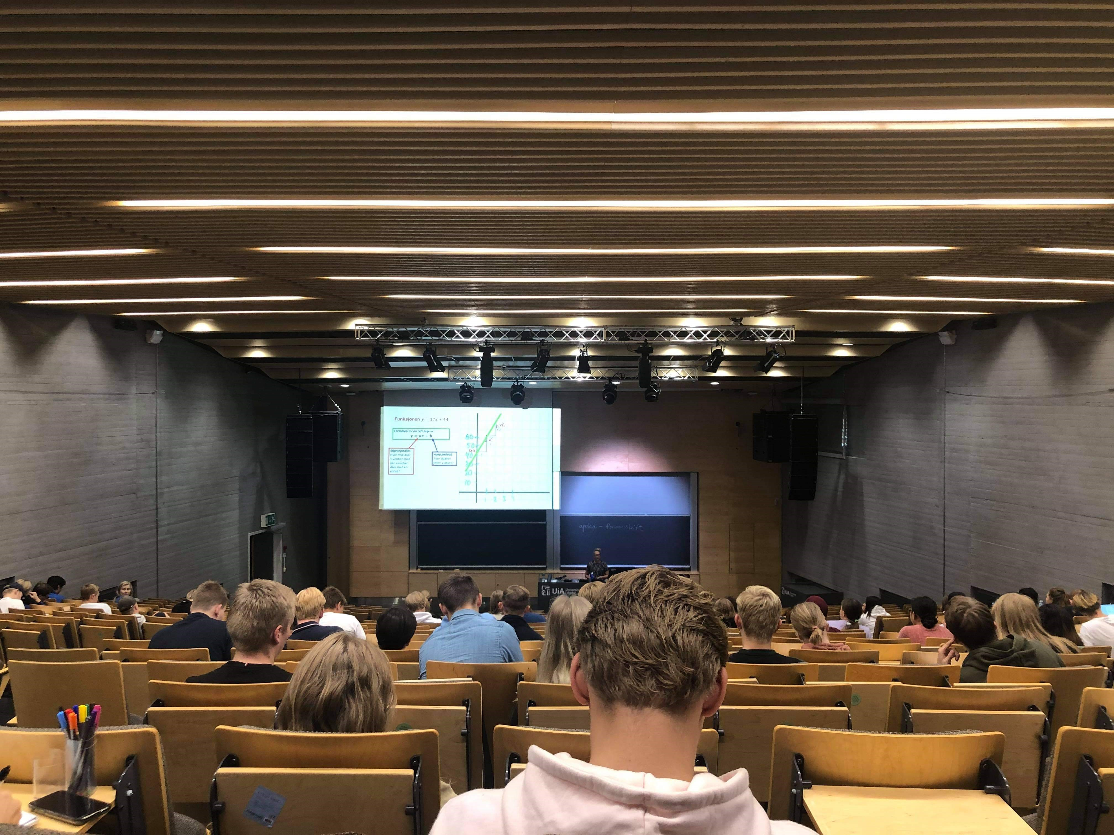
Background of the study
Large first-year mathematics course
Students struggle to recognise the relevance of the mathematics
Notes:
The course traditionally delivered by in large lectures by a single instructor, in combination with group work facilitated by student mentors.

Slide 3
SPVME- Project Student- Produced-Videos-in-Mathematics-Education
Role model
Have used mathematics in economics courses
Link between students and lecturer
Student perspective on being new at the university
…
An effort to enhance the quality of teaching and student engagement
Integrates the ‘student voice’ into instruction
Student mentors second- or third-year economics students
“Boundary” persons
Loch and Lamborn’s (2016) Maths Relevance Project
SPVs in engineering
Explain mathematics in “student’s language”
Notes:
by involving student mentors to create video resources on key mathematical concepts relevant to the first-year students in the mathematics course.
Student mentors are the boundary people here which brings in the student voice
They are the link between the lecturer and the large student group of first-year students
They are role models for the younger students
They know what difficulties the first year students meet
They have used math in economics courses
Which is the clue for our project
Loch and Lamborn’s: They found that the higher-year students were uniquely positioned to understand and address the challenges first-year students face in seeing the relevance of mathematics for their vocational courses

Slide 4
Aim of the project
We aim to understand:
How such resources act as an interdisciplinary bridge highlighting the relevance of mathematical concepts in economics.
How first year students engage with SPVs
The perceived affordances and constraints of SPVs
Practical contribution:
Resource bank
Knowledge about co-creation of resources with student mentors
Notes:
Students perception about SPV
Research project as well as developmental work

Slide 5
Student-produced videos
Mentors present mathematical concepts in an accessible and relatable manner by explaining their practical significance in other economics courses in the ‘student voice’.
16 videos on 8 topics
Fractions and percentage
Linear functions
Logarithms
Differentiation
Elasticity
Sequences and series
Integrals
Lagrange multiplier method
Videos distributed to the first-year students during the spring semester 2025

Slide 6
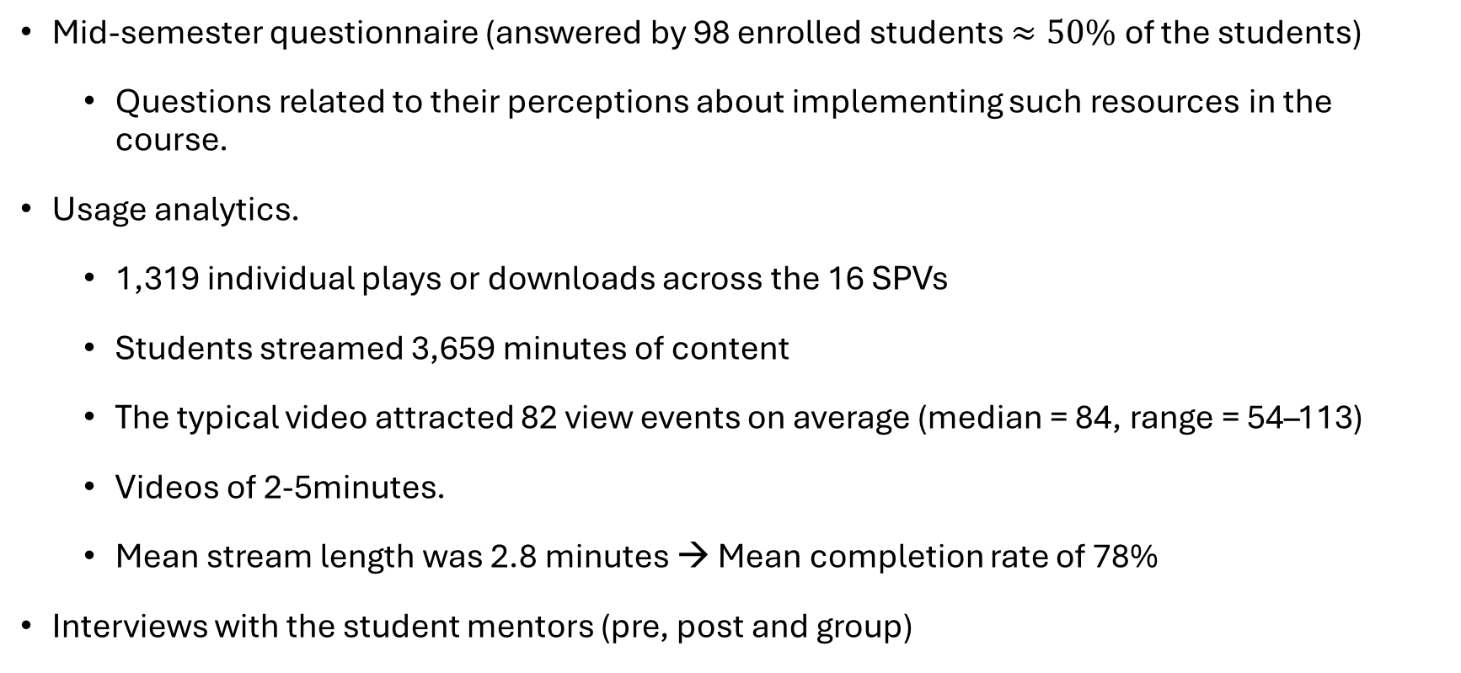
Data collection
Mid-semester questionnaire (answered by 98 enrolled students $≈50\%$ of the students)
Questions related to their perceptions about implementing such resources in the course.
Usage analytics.
1,319 individual plays or downloads across the 16 SPVs
Students streamed 3,659 minutes of content
The typical video attracted 82 view events on average (median = 84, range = 54–113)
Videos of 2-5minutes.
Mean stream length was 2.8 minutes → Mean completion rate of 78%
Interviews with the student mentors (pre, post and group)
Notes:
students streamed 3,659 minutes of content – equvivalent to approx. 61 hours.
Thus, students usually complete a video if they open it.

Slide 7
Data analysis and results
Engagement unevenly distributed across the videos
“Remedial” videos (fractions, percentage, etc) vs topics directly aligned with core syllabus items for the final examination (elasticity, derivatives, integration).
Questionnaire: “When in the semester do you expect the mentor videos to be most useful (e.g., pre-lecture preparation, post-lecture follow-up, pre-exam revision, or something else)?”
Responses inductively coded to identify themes.
Theme | % | Notes
Exam revision | 59% | Majority of responses emphasised videos as useful for revising content
Post-lecture consolidation | 9% | Some students linked videos to reinforcing lecture material
Pre-lecture preparation | 3% | Very few associated videos with preparing before lectures
Non-specific use / not yet watched | 29% | Participants either had not watched yet or answered non-specific
Notes:
Engagement unevenly distributed across the videos
- Topics directly aligned with core syllabus items for the final examination (elasticity, derivatives, integration) drew the most interest, while remedial or supplementary material attracted more modest interest.
- The two elasticity videos (“Elasticity – what is that” and “Elasticity – relevance in economics”) alone generated 214 view events and 13.8 hours of watching time.

Slide 8
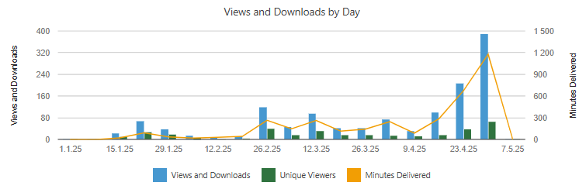
Data analysis and results
Notes:
Bilde som viser: Daily usage statistics corroborate these intentions:
viewing remained low through January,
rose modestly in late February and mid-March when, e.g., the elasticity videos were released,
and climbed sharply during the two weeks leading up to the 5th of May examination, peaking on the 30th of April with almost 400 plays and more than 1,200 streamed minutes.
The temporal spike, coupled with topic-specific popularity, indicates that students used the mentor videos primarily as last-minute revision aids, precisely as they had predicted in the questionnaire.

Slide 9
Data analysis and results
Questionnaire: “In what ways do you find that the mentor videos have been useful, and what challenges or limitations have you encountered when using them?”
61 students perceived the videos to be a useful resource
concise and flexible resources
clarify concepts
make revision easier
11 students mentioned challenges/limitations
some found the videos to be too short and shallow
The videos included too few examples
videos cannot replace real-time interactions with the mentors
26 responses did not discuss usefulness or challenges

Slide 10
Insights and further research
Results indicate:
SPVs were primarily used by first-year economics students as a strategic revision aid leading up to the final examination.
Students perceive SPVs as useful resources
Insights:
Younger students value extra learning material and benefit from having additional support beyond lectures.
Student voices matter – first-year students listen to what older peers explain in the videos.
SPVs add meaningful support to the learning process.
Future research:
Explore how SPVs can support learning earlier in the semester and be integrated within lectures to highlight the relevance of mathematics in economics.

Slide 11
Thank you!

